Slide 1



Coffee Queues,
Drive-Throughs,
Paradox
Of
Choice
Notes:
Spend about a minute talking about the “Ethos of Our Project”
Unlike myself, Dan is a big coffee drinker. So he approached me with a problem:
Dan: “Hey AJ, I am tired of waiting in drive through lines to get my morning Coffee!”
Me: “I Thought drive throughs were supposed to be convenient….”
Dan: “Well, maybe they would be if people the lines weren’t so long. The guy in front of me took 15 minutes to order while cars piled up behind him and ended up driving away with a small black coffee”
AJ: “Well how do you think we can make the process faster?”
Dan: “I dunno, lets do some analysis…”

Slide 2

COFFEE QUEUES: AMERICA RUNS ON COFFEE
Americans drink 400 million cups of coffee per day
On any given day, 36% of Americans buy Coffee
Out of the Coffee purchased, %50 percent came from a drive-thru
Notes:
ESSENSE: People Drink a lot of coffee.
*Americans are consuming record amounts of coffee bringing in about $81 Billion dollars in Revenue in 2019
This gives us an estimated 4 Billion dolllars in Drive through Sales alone
*This many americans consume coffee at home
*As moring coffee runs become more and more popular, people are having to waste there valuable time waiting in a drive through line
According to a study by the National Coffee Association: 1. In 2019, 64% of Americans aged 18 and over drank coffee every day. (NCA)
https://myfriendscoffee.com/usa-coffee-statistics/
https://myfriendscoffee.com/usa-coffee-statistics/

Slide 3


DRIVE THROUGHS: An Inconvenient Convenience
Drive throughs rose with a goal: to make fast food even faster
Average drive through service time increased 20s from 2018
60-70% of a restaurant's revenue comes from drive through designs
Notes:
*Drive through restaurants began in the 1950s as an extension of carhops with one goal in mind: to make fast food even faster. Their popularity started to explode in the 1970s with the rise car culture, and more and more women were going to work
But this boom never really settled, in a 2019 study, fast food restaurants usage has increased 39% since 2018
* But with this rise in popularity, we see Average drive through service time increased 20-seconds from 2018. 20 seconds matter to your day? It’s an insignificant sum, nothing you might notice while waiting in a drive-thru for your lunch. Multiply that by the 68 million people McDonald’s serves each day, and lines are backed up by 43 years. If just one in 100 people deem that wait too long, McDonald’s loses hundreds of thousands of dollars in revenue each day.
60-70% of a restaurant's revenue comes from drive through designs It is an important to keep these drive throughs fast, as they are starting to give way to third party delivery sources like uber eats. So to combat this, restaurants have pored millions into digital menu board, dual lane drive throughs, and artificial intelligence.
Chick fil a CFO Jack Hartung believes that ordering times are a huge contributor to this, so I will change the focus a little bit: instead of making menu boards more intelligent, make them simpler.
*https://www.fastcompany.com/3023645/why-drive-thru-dining-is-getting-slower
*https://www.youtube.com/watch?v=RI0xj8aaTlE

Slide 4


The Paradox of Choice: Optimizing decisions
Decreasing number of choices can decrease anxiety and decision time
Menu reduction could simultaneously improve service times and customer experience
Hicks law: T = b*log₂(n + 1)
T: Total Decision Time
n: number of choices
Notes:
*https://en.wikipedia.org/wiki/Hick%27s_law
The paradox of choice, coined by American psychologist Barry Schwartz is the idea that eliminating consumer choices can greatly reduce anxiety and “paralysis by analysis” for shoppers. psychologists Sheena Iyengar and Mark Lepper, found that customers were 10 times more likely to purchase jam on display when the number of jams available was reduced from 24 to 6
Hicks law: describes the time it takes for a person to make a decision as a result of the possible choices: increasing the number of choices will increase the decision time logarithmically.

Slide 5
Problem Statement:
Study the effects of:
Menu Simplification
Parallel ordering windows
On Dunkin’ Drive-thru Wait & Service Times
Project how these changes might affect profits
Notes:
*Americans are consuming record amounts of coffee
*This many americans consume coffee at home
*As moring coffee runs become more and more popular, people are having to waste there valuable time waiting in a drive through line
According to a study by the National Coffee Association: 1. In 2019, 64% of Americans aged 18 and over drank coffee every day. (NCA)
https://myfriendscoffee.com/usa-coffee-statistics/

Slide 6
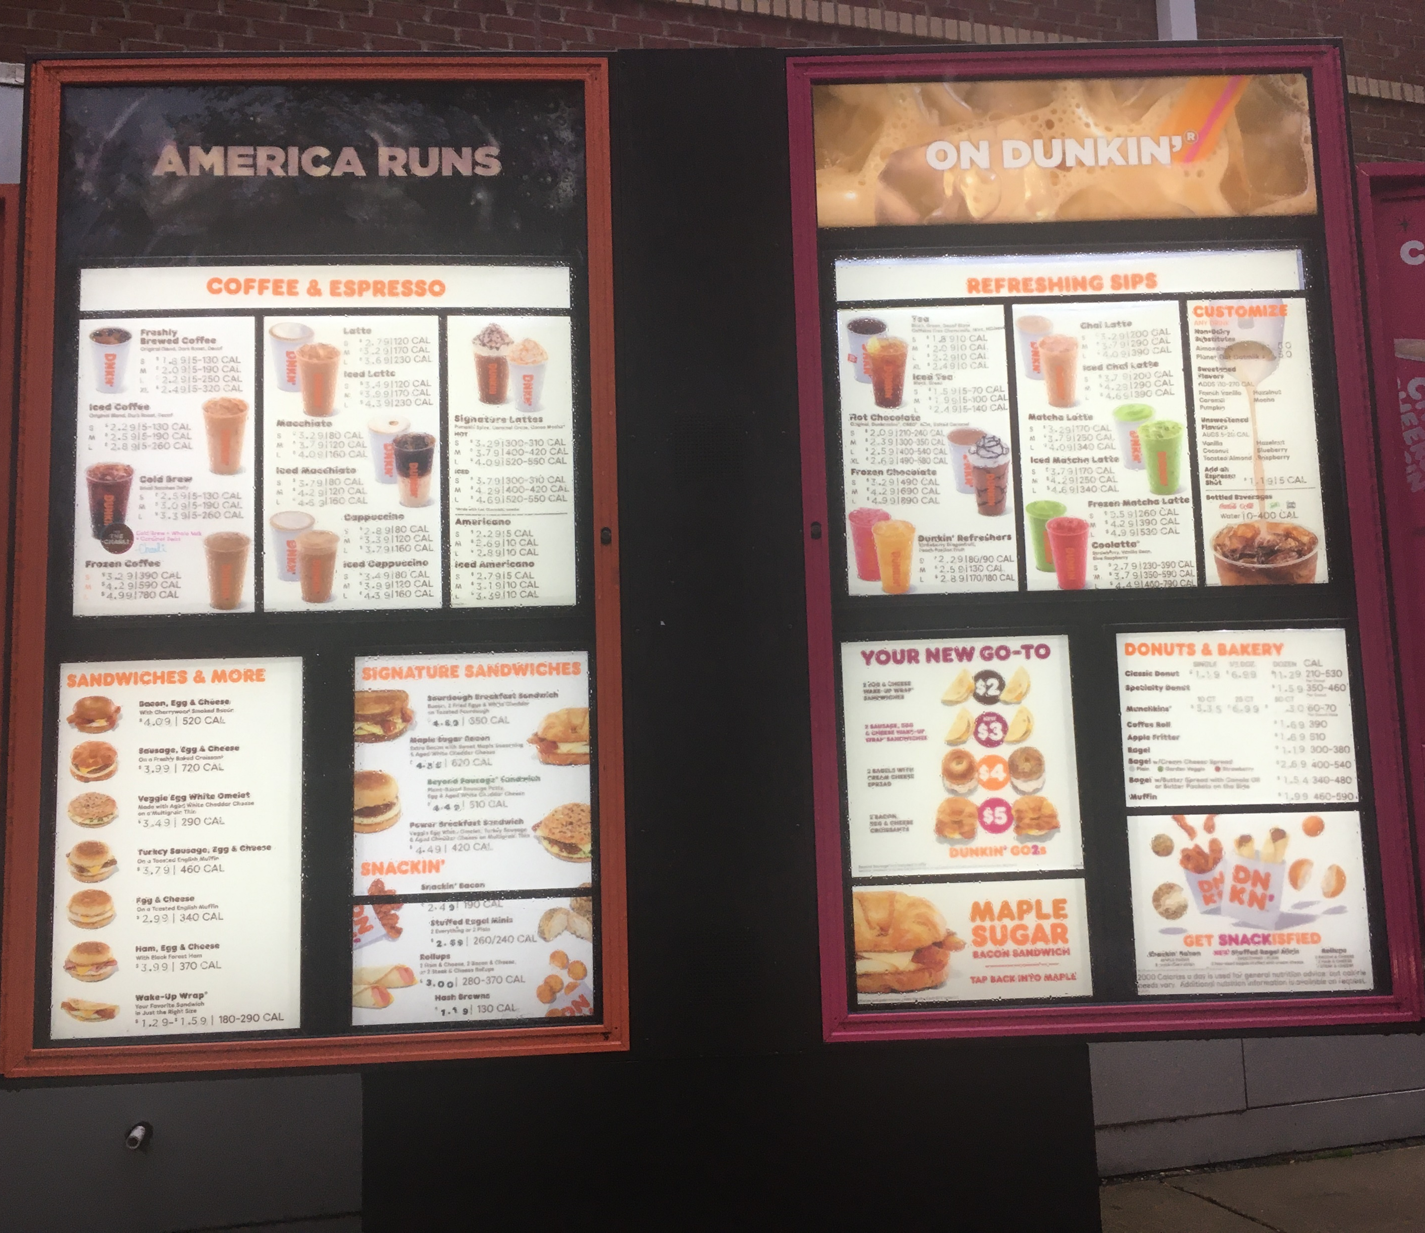
Hypothesis:
Reducing menu size will improve profits at Richmond road Dunkin’

Slide 7
Item | Popularity (Prob Order) | Price | Quantity
Iced Coffee | 0.301365578 | $2.59 | 1
Hot Coffee | 0.150682789 | $2.92 | 1
Breakfast Sandwiches | 0.100455193 | $4.03 | 10
Donuts | 0.075341395 | $4.69 | 5
Wake-up Wrap Sandwiches | 0.060273116 | $1.49 | 1
Iced Espresso | 0.050227596 | $3.87 | 4
Hot Espresso | 0.043052225 | $3.29 | 4
Cold Brew | 0.037670697 | $3.09 | 1
Bagels | 0.033485064 | $1.81 | 3
Iced Tea | 0.030136558 | $1.99 | 1
Frozen Drinks | 0.023461958 | $4.17 | 4
Hot Chocolate | 0.023461958 | $2.39 | 1
Other Iced | 0.023461958 | $3.72 | 3
Other Lattes | 0.023461958 | $4.17 | 8
Snackers | 0.023461958 | $3.50 | 1
Notes:
*Americans are consuming record amounts of coffee
*This many americans consume coffee at home
*As moring coffee runs become more and more popular, people are having to waste there valuable time waiting in a drive through line
According to a study by the National Coffee Association: 1. In 2019, 64% of Americans aged 18 and over drank coffee every day. (NCA)
https://myfriendscoffee.com/usa-coffee-statistics/

Slide 8
Testing Hypothesis: Ordering
Collect Inter-Arrival and Inter-Departure times:
Service time calculated from there Lindley (1952)
Using a SW test in R, fit a distribution to each
Input these distributions into SSQ3 and collect data such as queue length and wait times
Notes:
100 data values collected from dunkin donuts on Richmond Road. Inter-arrivals were measured as the time between cars lining up in the drive through. Interdepartures were measured as the time between departing ordering window. (ignoring the pay window which happened after the ordering window). Service times were calculated via https://arxiv.org/pdf/1703.02151.pdf an algorithm by Lindley (1952).

Slide 9
Test Hypothesis: Purchases
For each job, randomly sample an item from Dunkin’s menu, sum up the total purchases. **Sampling is based on item popularity data from Dunkin’ Website**
Every time the queue is greater than 15, cars the customer leaves with a certain probability (impatience vector) and the purchase is lost (subtract this from the total Revenue)
Notes:
1. Iced Coffee
2. Hot Coffee
3. Breakfast Sandwiches
4. Donuts
5. Wake-up Wrap® Sandwiches
6. Iced Espresso
7. Hot Espresso
8. Cold Brew
9. Bagels
10. Iced Tea
11. Frozen Drinks
12. Hot Chocolate
13. Other Iced Drinks
14. Other Lattes
15. Snackers

Slide 10
Test Hypothesis: Simplification
One of 15 categories of items is removed from the menu. Service time decreases by Hicks law
The total cumulative wait time saved is “spent” at Dunkin’, based on the “value of money”
The revenue from the removed item is lost
Notes:
1. Some categories of Items have

Slide 11
Assumptions
The simulation is run during 2 peak hours, weekdays, 50 weeks queue emptied at the end of each “Day”
“Specialties” and “embellishments” are not taken into consideration as number of choices
Everyone spend the average price of the medium sizes of the item in the category they choose
“Fixed Expenditure Universe”: time saved = money spent.
Notes:
1. Some categories of Items have

Slide 12
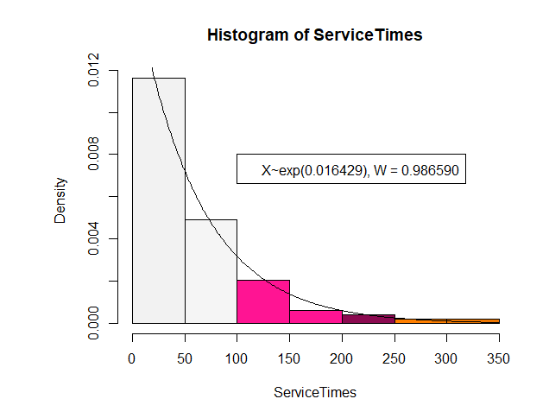
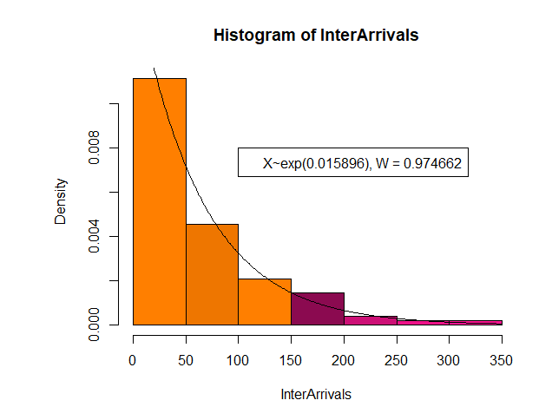


Parameters: Service and Arrival Ra
Mean Service Time $≈60 seconds$
Mean Arrival Time $≈62 seconds$
Parameter: Service and Inter Arrival
Notes:
2.
Iced Coffee Hot Coffee Breakfast Sandwiches Donuts Wake-up Wrap Sandwiches Iced Espresso Hot Espresso Cold Brew Bagels Iced Tea Frozen Drinks Hot Chocolate Other Iced Other Lattes Snackers
0.301366 0.150683 0.100455 0.075341 0.060273 0.050228 0.043052 0.037671 0.033485 0.030137 0.023462 0.023462 0.023462 0.023462 0.023462

Slide 13

Parameters: Service and Arrival Ra
Time Value $≈0.085 cents/seconds$
Impatience Vector:
If 15 <= q <=16
Leave wp 0.05
If 17 <= q <=18
Leave wp 0.10
If 19 <= q <= 20
Leave wp 0.20
Leave wp 0.40
Leave wp 0.50
If q > 22
If 20 <= q <= 22
Income Per Capita- Williamsburg ($26,921)
31,536,000 Seconds/year
Time Value = $26,921/31,536,000 =
0.00085
Parameters: Time Value Stats
Notes:
2.
Iced Coffee Hot Coffee Breakfast Sandwiches Donuts Wake-up Wrap Sandwiches Iced Espresso Hot Espresso Cold Brew Bagels Iced Tea Frozen Drinks Hot Chocolate Other Iced Other Lattes Snackers
0.301366 0.150683 0.100455 0.075341 0.060273 0.050228 0.043052 0.037671 0.033485 0.030137 0.023462 0.023462 0.023462 0.023462 0.023462

Slide 14
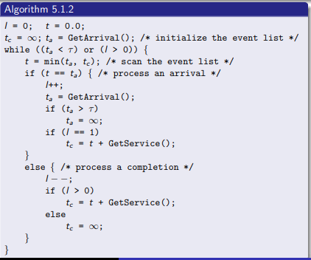

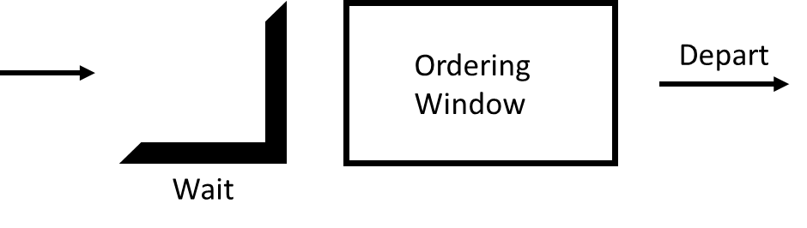
Adj Menu Revenue
Service, Arrival Times
Hicks Law
Service Time = Hicks (45 – quant(item Removed))
Rerun SSQ3, Remove Purchases = RemovedItem
Sum(Purchases)
Add Time Saved = (TWT – Prec TWT)*Time Value
Time Value
Removes Item
SSQ3 Algorithm
Purchases
Revenue
Compare
Revenue
*SSQ3 for 2 hours, repeat, cumulate/avg results
“Completed Jobs” many random numbers from Price Prob PDF (Purchases)
If Q within “Impatient Level” remove Purchase wp Imp Vect
Sum the purchases (rev)
Total Wait Time, Number of Completed Jobs, Queue Lengths per Job Arrival
Price/Prob,
Imp Vector

Slide 15
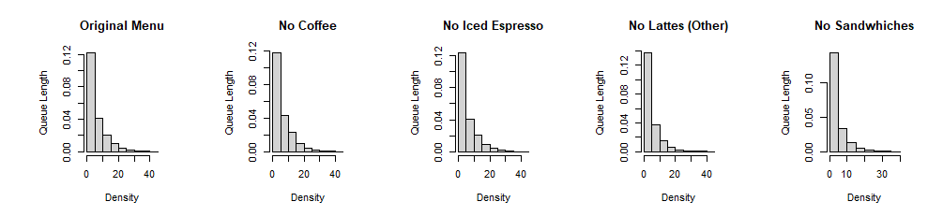
Results: Queue Distributions
2437
2233
2256
1441
1491

Slide 16
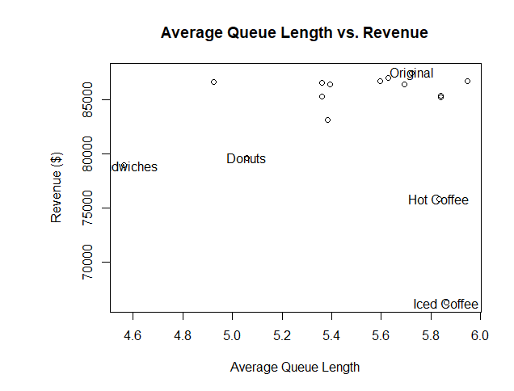
Results: Waiting Game

Slide 17
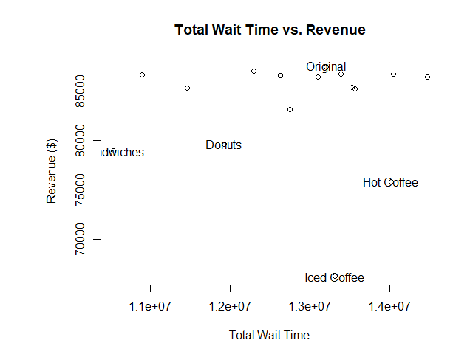
Results: Time is money?

Slide 18
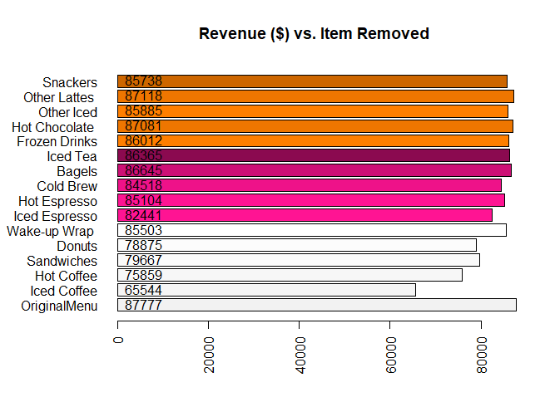
Results: original parameters
***Optimal Revenue: $877777 (Original Menu)****

Slide 19
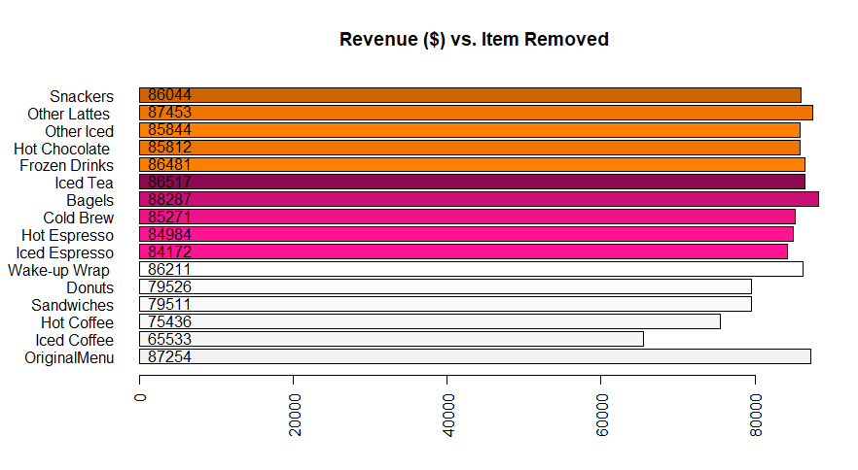
Results: Impatient Crowd
***Optimal Revenue: $88287 (Original Menu)****
$1033 saved
Notes:
rev(c(0.30, 0.4, 0.5, 0.6, 0.7))

Slide 20
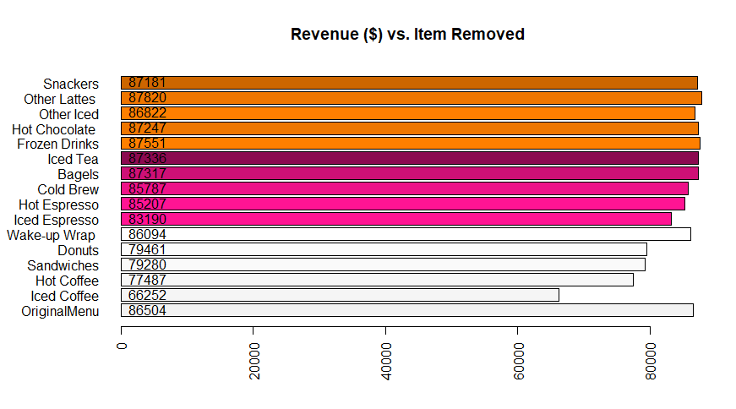
Results: New England
***Optimal Revenue: $87820 (Original Menu)****
$1316 saved
Notes:
rev(c(0.005, 0.01, 0.02, 0.04, 0.05))

Slide 21
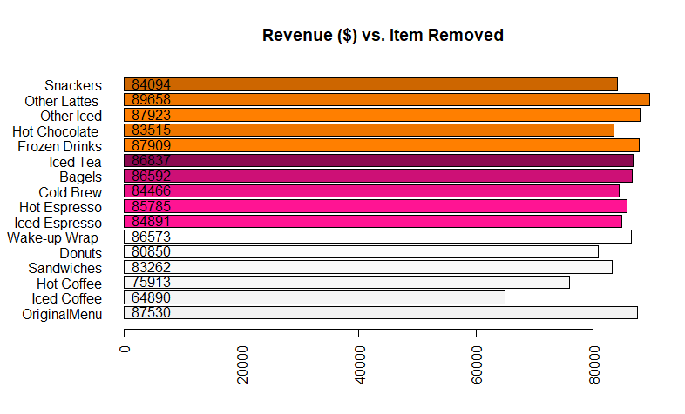
Results: Professor Party
***Optimal Revenue: $89658 (Original Menu)****
$2128 saves
Notes:
People value there time at 74000 a year

Slide 22
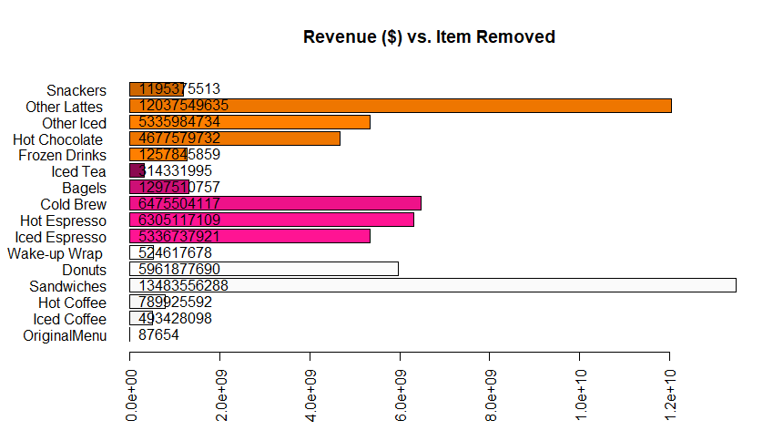
Results: Jeff Bezos
Notes:
People value there time at 74000 a year

Slide 23
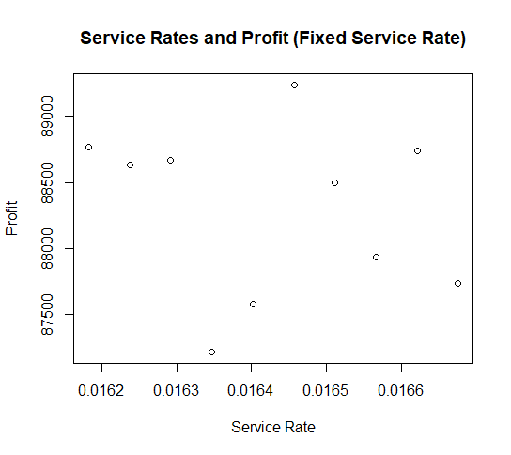
Sensitivity Analysis: Service Rate
Notes:
People value there time at 74000 a year

Slide 24
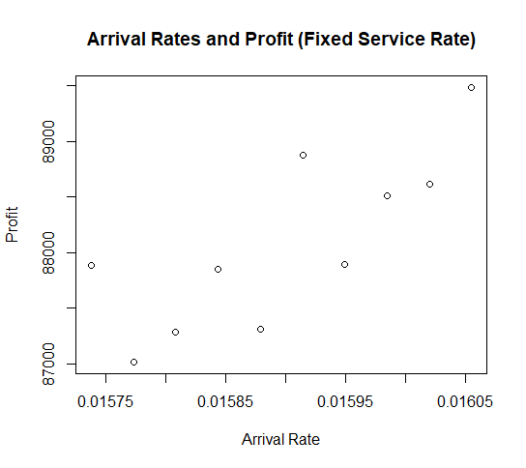
Sensitivity Analysis: Arrival Rate
Notes:
People value there time at 74000 a year

Slide 25
Conclusion and Further work
There is qualitative evidence that removing nonpopular, highly varied items from the Dunkin’ menu can increase revenue.
Analyze the “Stochasticity” of the model: develop a stronger quantitative basis for the conclusions. Are the variations in profit due to the random variations in service and arrival times?
Data Collection:
More details on item popularity (folks don’t always order Medium).
See if these results change for nonpeak hours.
Track when jobs leave the queue for a better “Impatience Vector”
Model Alterations
Consider other “ordering time” predictors than just menu size
Notes:
People value there time at 74000 a year

Slide 26
Sources
https://arxiv.org/pdf/1703.02151.pdf
W. E. Hick (1952): On the rate of gain of information, Quarterly Journal of Experimental Psychology, 4:1, 11-26
https://www.fastcompany.com/3023645/why-drive-thru-dining-is-getting-slower
*https://www.youtube.com/watch?v=RI0xj8aaTlE
Notes:
People value there time at 74000 a year

Slide 27
